Slide 1
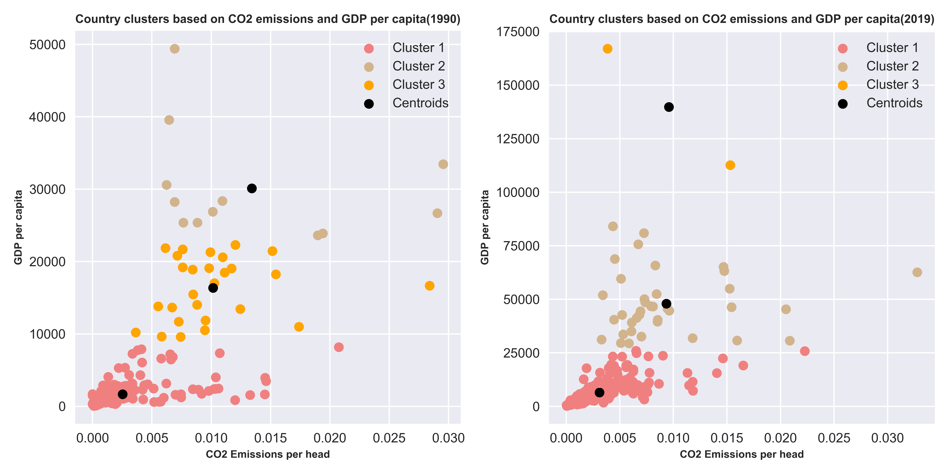
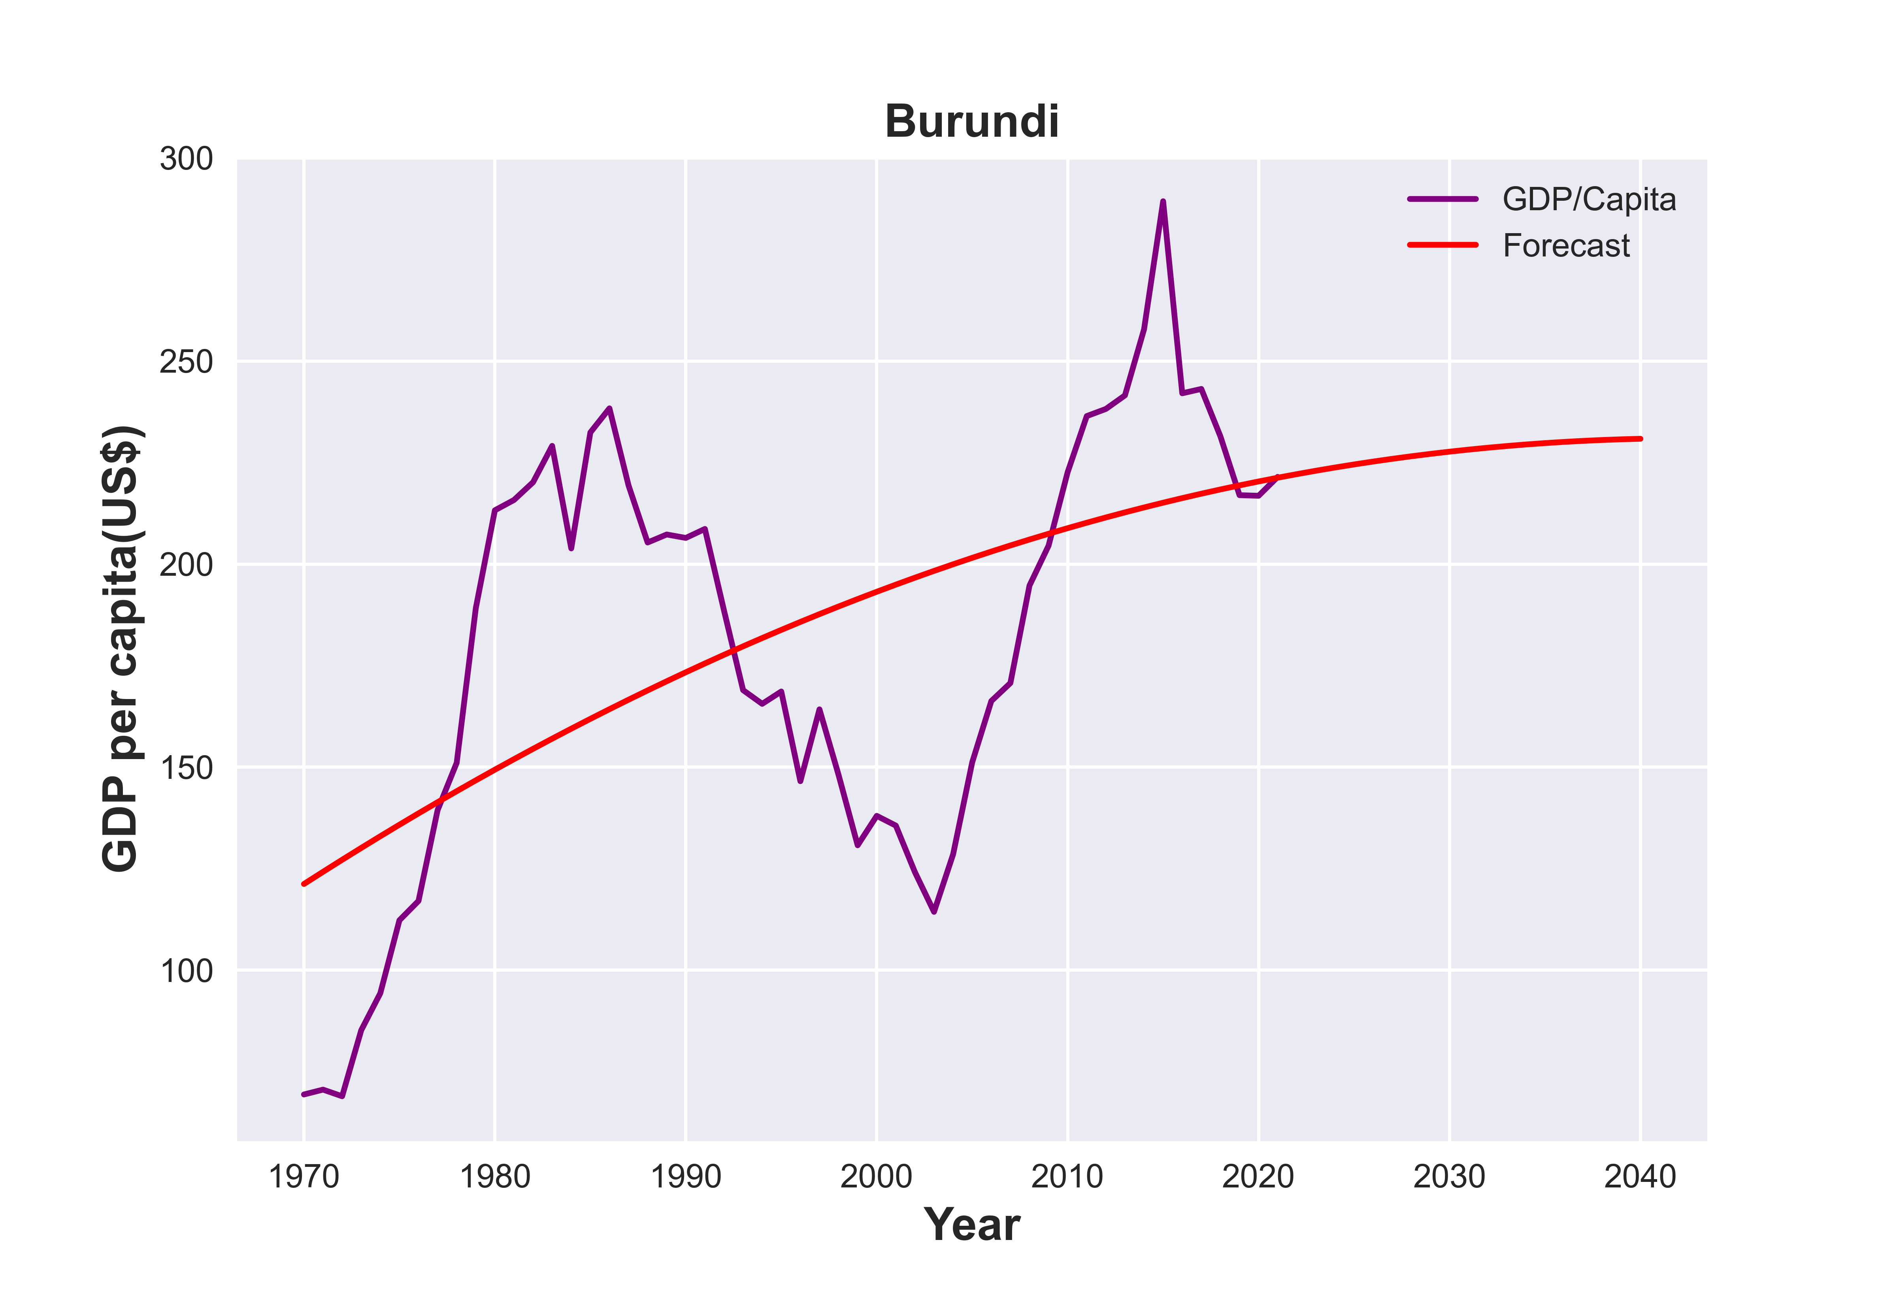
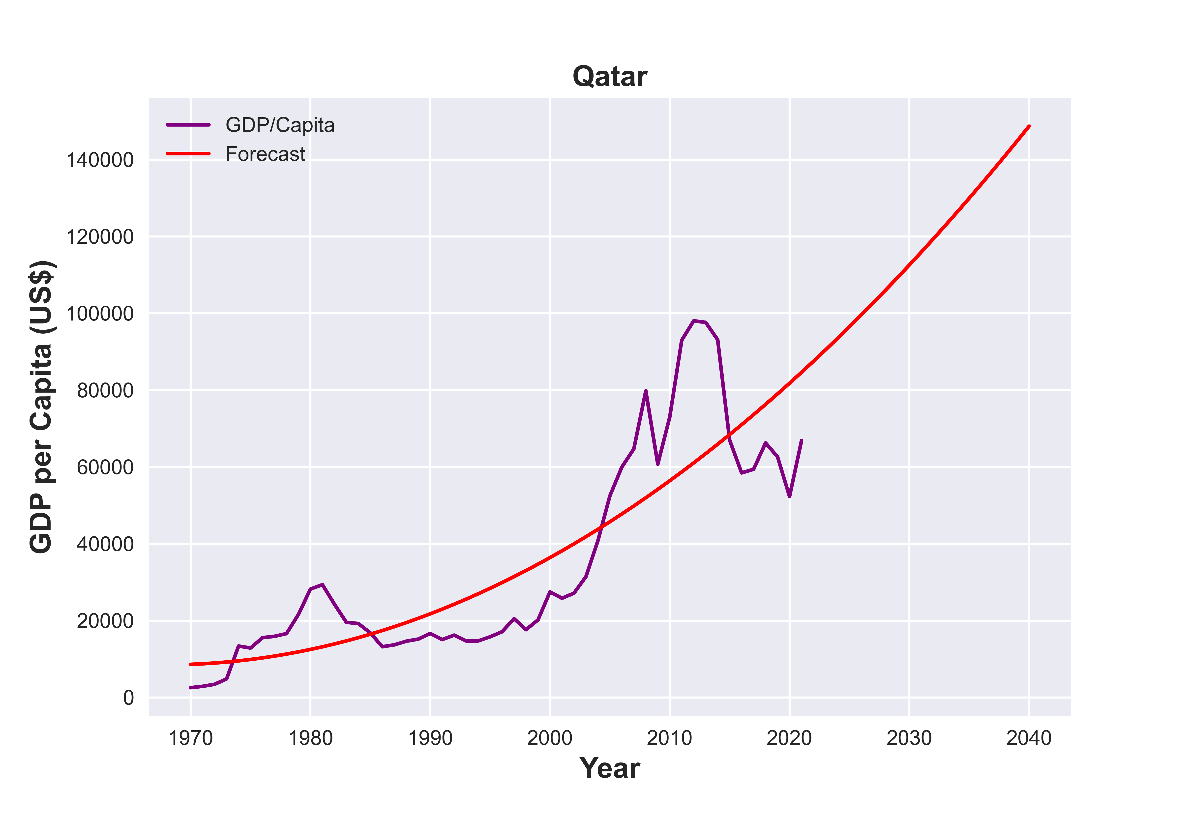
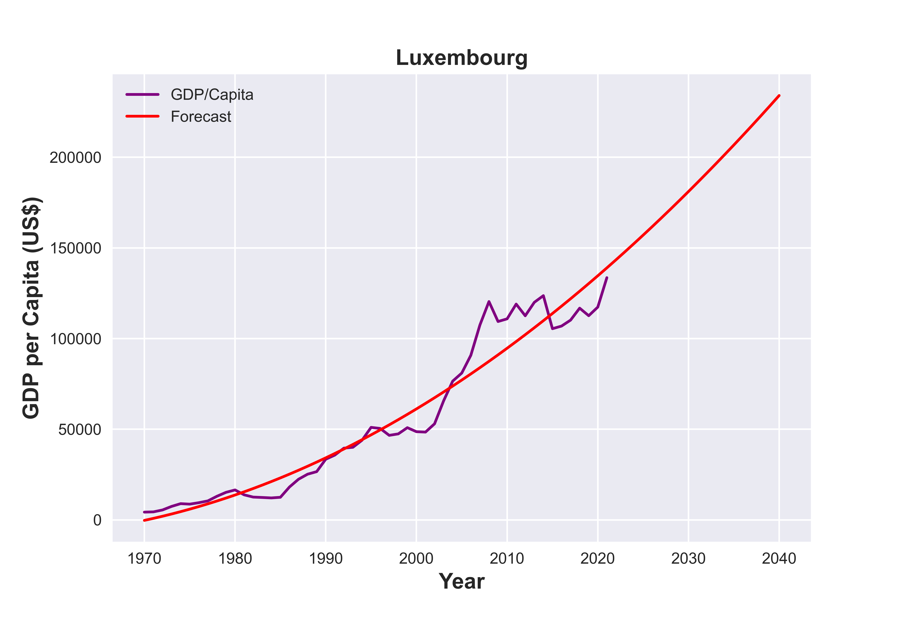
Economic effects on Climate change
By Okeogheneomaero Evru (22030848)
INTRODUCTION
The rise in industrial, commercial, and economic activity has caused major and long-term changes in temperatures and weather patterns, which are referred to as "climate change.” Changes in rainfall patterns, increasing temperatures, rising sea levels, and other natural phenomena that many experts have warned could have an influence on human life are some effects of climate change. In order to lessen the threats it poses to humanity and way of life, it has thus been the subject of many conversations among world leaders. This study aims to take a look at one of the major causes of climate change which is CO2 emissions and further relate it to the GDP per capita of a country.
BODY
Figure 1 above shows the cluster analysis of countries around the world based on CO2 emission per head and GDP per capita. The analysis was performed for the years 1990 and 2019 to observe how clusters change over time. The goal is to shed light on how economic factors and CO2 emissions relate to one another. Most countries can be seen to have reduced CO2 emissions per head over the years as the clusters can be seen to move leftward. However, GDP per capita can be said to have increased between 1990 and 2019. based on the graph.
GDP PER CAPITA PROJECTIONS
Three countries - one from each cluster in figure 1 - have been chosen to show GDP per capita projections for the next 20 years (from 2021). Burundi is one of the countries with the lowest CO2 emissions per head and GDP per capita while Qatar and Luxembourg represent medium and the highest CO2 emissions per head and GDP per capita respectively. Figure 2 below shows the forecasted growth rate for GDP per capita in each of these countries.
BURUNDI
LUXEMBOURG
QATAR
The forecast for GDP per capita in Burundi does not look to be increasing, but rather headed towards a steady state in the next 20 years. It is more likely that the country will not experience that much economic growth anytime soon.
The GDP per capita of Qatar is projected to increase exponentially and continue to soar in the next 20 years. The country will most likely experience large economic growth rate in the coming years.
There is a projected exponential growth in GDP per capita which shows that Luxembourg will continue to be one of the richest nations in the world and increase its economic standing.
CONCLUSION
This study helps to identify that CO2 emissions per head has reduced possibly due to the increase in global population over the years and while GDP per capita is generally on the rise, it can be inferred that this may lead to further environmental pollution due to factors such as urbanization. Necessary and adequate steps need to be taken to ensure that the climate does not bear the cost of global technological advancements.
Github link: https://github.com/maeintech/ADS1---Assignment3
Data Sources:
https://api.worldbank.org/v2/en/topic/19?downloadformat=excel
https://api.worldbank.org/v2/en/indicator/NY.GDP.PCAP.CD?downloadformat=excel

